Slide 1
Upgrade Angular Project From 9 to 14

Slide 2
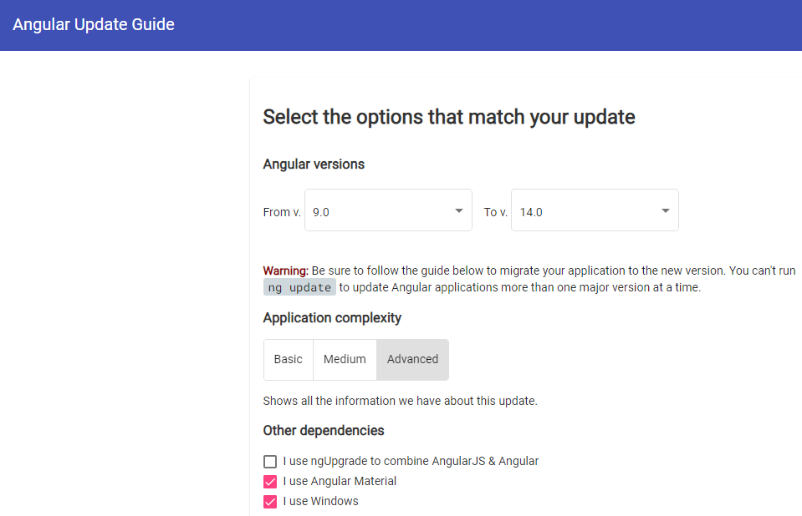
Reference: https://update.angular.io/?l=3&v=9.0-14.0

Slide 3

Demo
Upgrade Angular Project From 9 to 14

